Slide 1
Primer on Qualtrics Randomization using Javascript

Slide 2

Two ways of information persistence
Embedded Data
Persists data across survey questions
However, relationships between embedded data can be tough to enforce without code
Variables
Only persists within the code block (not even within the question)
Relationships are easier to manage because …. Code!

Slide 3

Consider the simplest case where default Qualtrics fails…
You have 9 images -3 happy, 3 sad and 3 neutral
You want to present them such that you randomly show 1 sad, 1 happy and 1 neutral image and then repeat this three times
Amazing at it may seem, this simple randomization is not part of the default Qualtrics toolkit.
But with a little bit of scripting…..

Slide 4
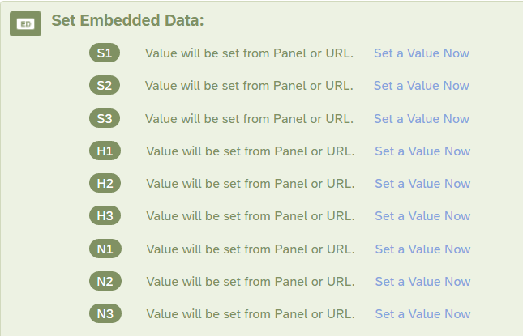
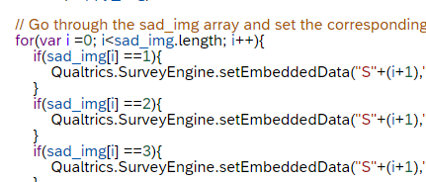
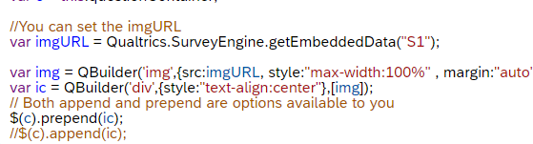
The Trick
Set up embedded data variables for information that you want persisted
Configure, Slice, Dice, Randomize variables &
Store in Embedded Data
Use configured embedded data at the question level

Slide 5
Some other use cases
Making the “next” arrow appear after a lag – forcing people to stay on the page for some time
Changing the color of the text randomly – stroop tasks
Piping text from one set of questions to another (individual pipes can be done with default Qualtrics)
Making text disappear after some time

Slide 6
Resources
https://psrc.princeton.edu/sites/psrc/files/html_tips_tricks.pdf
https://www.simonho.ca/data/qualtrics-conditional-images/
https://jsfiddle.net/Taqi_Shah/0zshgg1a/ (JS Fiddle for playing around with javascript OUTSIDE of Qualtrics before importing it in)
https://www.qualtrics.com/community/discussion/7455/javascript-embedded-name-randomization-across-questions (The Qualtrics Support forum – but can be a rabbit hole)

